Slide 1
The Right Loom for Me
By members of the Rag Rug Study Group: Judy Larson, Barb Yarusso, and Linnie York

Slide 2
Things to Consider When Choosing a Loom
What do you want to weave? How wide do you want to weave?
Scarves, bands, and runners work on narrow looms. Rugs, blankets, and large weavings require wider looms.
Rugs require a sturdy floor loom. Most other weavings can be done on any loom.
Do you have any physical mobility constraints? Is the loom adjustable to fit your body?
Shoulder, back, knee or hip problems? Very tall or very short? Some looms have adjustable benches and beater bar heights.
How much room do you have? Does it need to be portable? Can you take it apart to move it?
Some looms fold or come apart for transporting or storing.

Slide 3
Is this your first loom? Do you want to weave with more than 4 shafts?
If it is a used loom, are all parts functioning? Is it sectional warped? Do I need a warping board or mill?
Many weavers acquire more than one loom. More shafts allow more pattern choices, but you can weave a lifetime with 4! Buy a used loom from an experienced weaver, or have a weaver check it out.
What is your budget? What is available for loom choices now? Are you willing to wait for a specific loom?
You can upgrade to a better loom as your skills increase. Used floor looms are usually at least $400 for a 4 shaft loom. New floor looms can be $1500 and up.
What learning resources are available? Is the company still in business if I need manuals or parts?
Local weavers or Guilds are priceless!

Slide 4
Loom Vocabulary
Warp is held between a back beam and a front or cloth beam.
Warp strings go thru heddle eyes or slots and holes on a rigid heddle.
Sheds are created by raising and lowering heddles that hold warp strings.
Shafts hold the heddles and are moved by levers or treadles, or lifted by you.
Shuttles are used to move the weft across the warp that is raised or lowered in the shed.
Beater bars hold the reed to compress the wefts in the warp to create the weavings.
Brakes control the tension on the warp strings, and allow you to advance the warp as you weave.

Slide 5
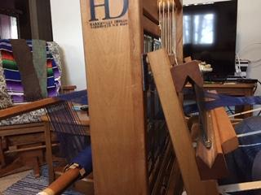
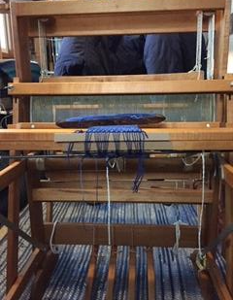
Parts of a Loom
Shafts with heddles
warp
shed
Beater bar with reed
Shuttle with weft
Cloth beam or front beam
Back beam and brake
Treadles

Slide 6
If you love :
Flexibility, mobility, and low cost, try a rigid heddle or table loom.
Making small weavings and quick projects, try a rigid heddle or table loom.
Figuring out patterns and repetitions, try a floor loom or table loom.
Making rugs and large weavings, try a floor loom.
Doing all kinds and sizes of weaving, try a floor loom.
Progressive challenges and more complex patterns, try an 8 shaft floor loom or Dobby loom.
.

Slide 7
Rigid Heddle Loom
By: Schacht Ashford Kromski Beka Glimakra
Good for scarves, runners, place mats, towels, and other small weavings.
Hole and Slot rigid heddle functions as both reed and heddles.
Direct warping technique warps directly onto loom.
Patterns: Tabby or plain weave, but can use pickup to make more patterns.
Footprint: 10 x 10 inches to 36 x 36 inches, 10-12 inches high.
Portable
Attaches to stand or tabletop.
Affordable and versatile.
Schacht Cricket 10” or 15” width $200
Schacht Flip 15, 20, 25, 30 inch widths $290 and up
Can use two rigid heddles to make 4 shaft patterns.

Slide 8
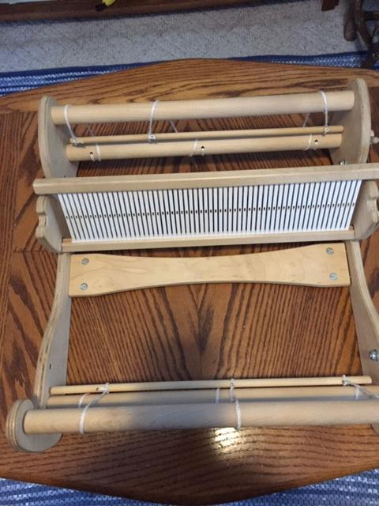
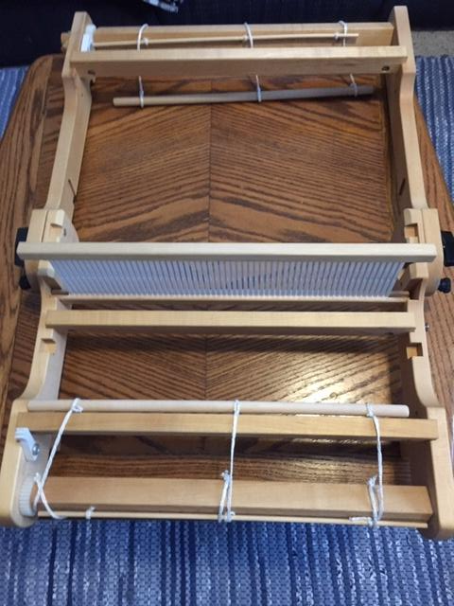
Schacht Flip Rigid Heddle Loom 15” width, allows for two rigid heddles to be used for 4 shaft patterns
Schact Cricket Rigid Heddle Loom 15 “ width

Slide 9
Table Looms by Glimakra Ashford Schacht Louet LeClerc
Good for towels, runners, scarves, tapestries, and small weavings.
Levers are moved to make the sheds, so lots of possible patterns.
Available in 2, 4, 6, 8, 12 or 16 shafts, so pattern choices expand with more shafts.
Most fold up for portability. Some have stands.
Footprint: 15x 30 to 36 x 48 inches, 24-36 inches high.

Slide 10
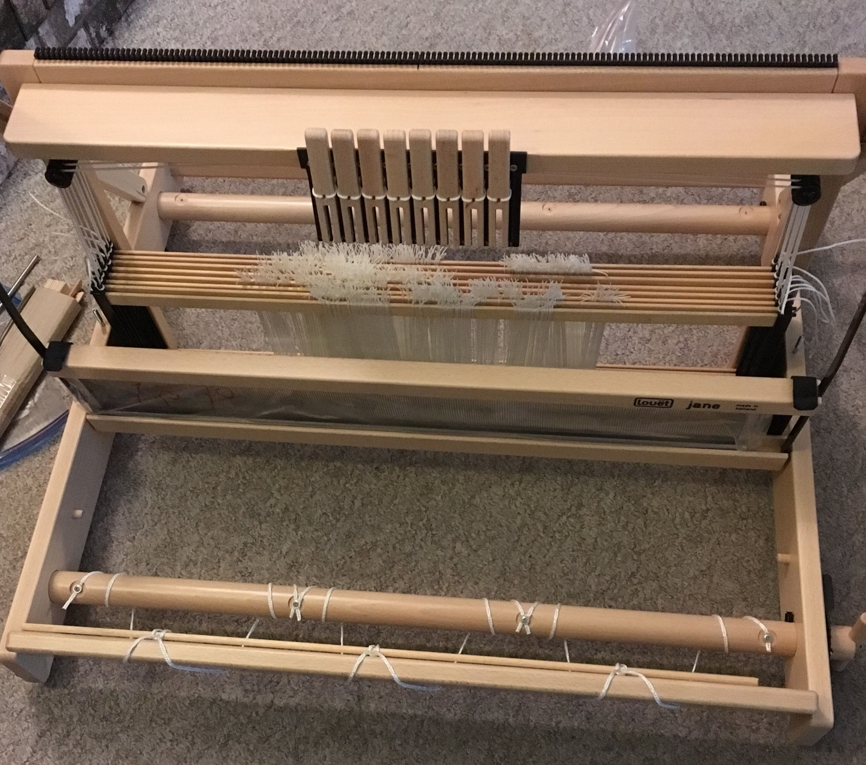
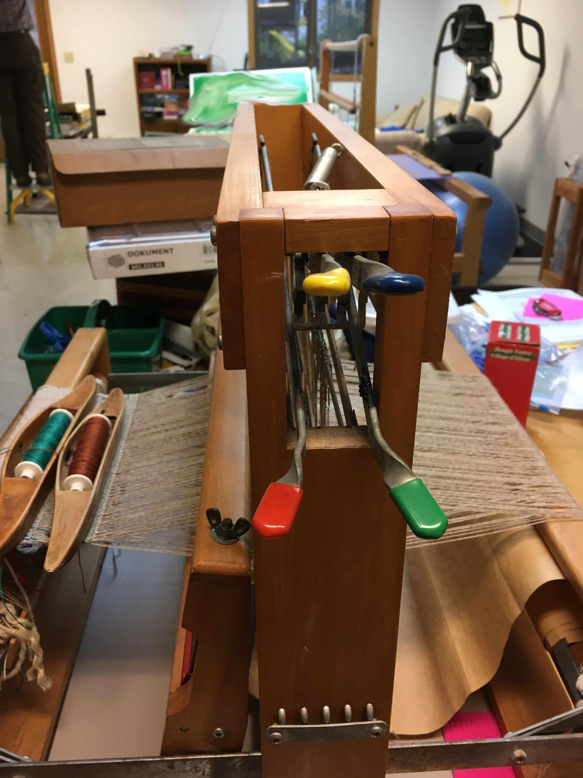
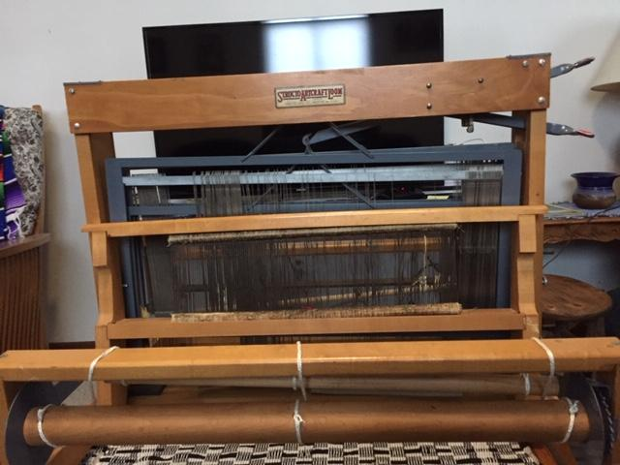
Front levers on 8 shaft loom
Locking Levers
Side levers on a 4 shaft Structo Artcraft Loom

Slide 11
Floor Looms
Good for weaving rugs, scarves, runners, blankets, and also finer weavings.
Rugs require a strong frame that supports good tension.
Shafts: 2, 4,6,8,10, 12, or 16. Pattern choices increase with shafts.
Footprints vary from 22 x 36 to 72 by 60. Height also varies from 36 to 72 inches tall.
Some come apart for moving, or have parts that fold in for transporting.
Some have beams and beater bars that can be removed to allow for easy access to thread the heddles.
Some have adjustable heights for the beater bar and bench.

Slide 12
Types of Floor Looms
Jack/ Direct Tie up looms raise shafts to put a set of warp strings under tension while the other warps rest on the shuttle race. The shafts are raised by jacks that push the shafts up, or a pulley and cord that lift the shafts up.
Counterbalance looms raise and lower shafts thru a roller or pulley system, so shafts are raised or lowered in opposing pairs.
Countermarche looms have double sets of lamms so every shaft is raised or lowered to keep tension consistent.

Slide 13
Jack Looms/Direct Tie Up looms by Schacht Harrisville Kessenich Newcomb Norwood Louet Gilmore Macomber
2,4,6,8,10, 12, 16 shafts
Footprints: 22x36 to 60x 60, 36-60 inches high.
Some fold up. Some have removable front beams.
Metal heddles- inserted eye or directional eyes on metal bars.
Treadles are attached to one set of lamms. Easy to change tie ups. More than one treadle can be depressed at a time.
Jacks raise the shafts when the treadles are depressed.
Direct Tie Up looms raise shafts by connecting a treadle with a cord running over a pulley.
One set of warp strings is at tension while the others rest on the shuttle race. Too much tension causes resting shafts to float up, creating a smaller shed.
Some have a strong frame for rugs, some do not.

Slide 14
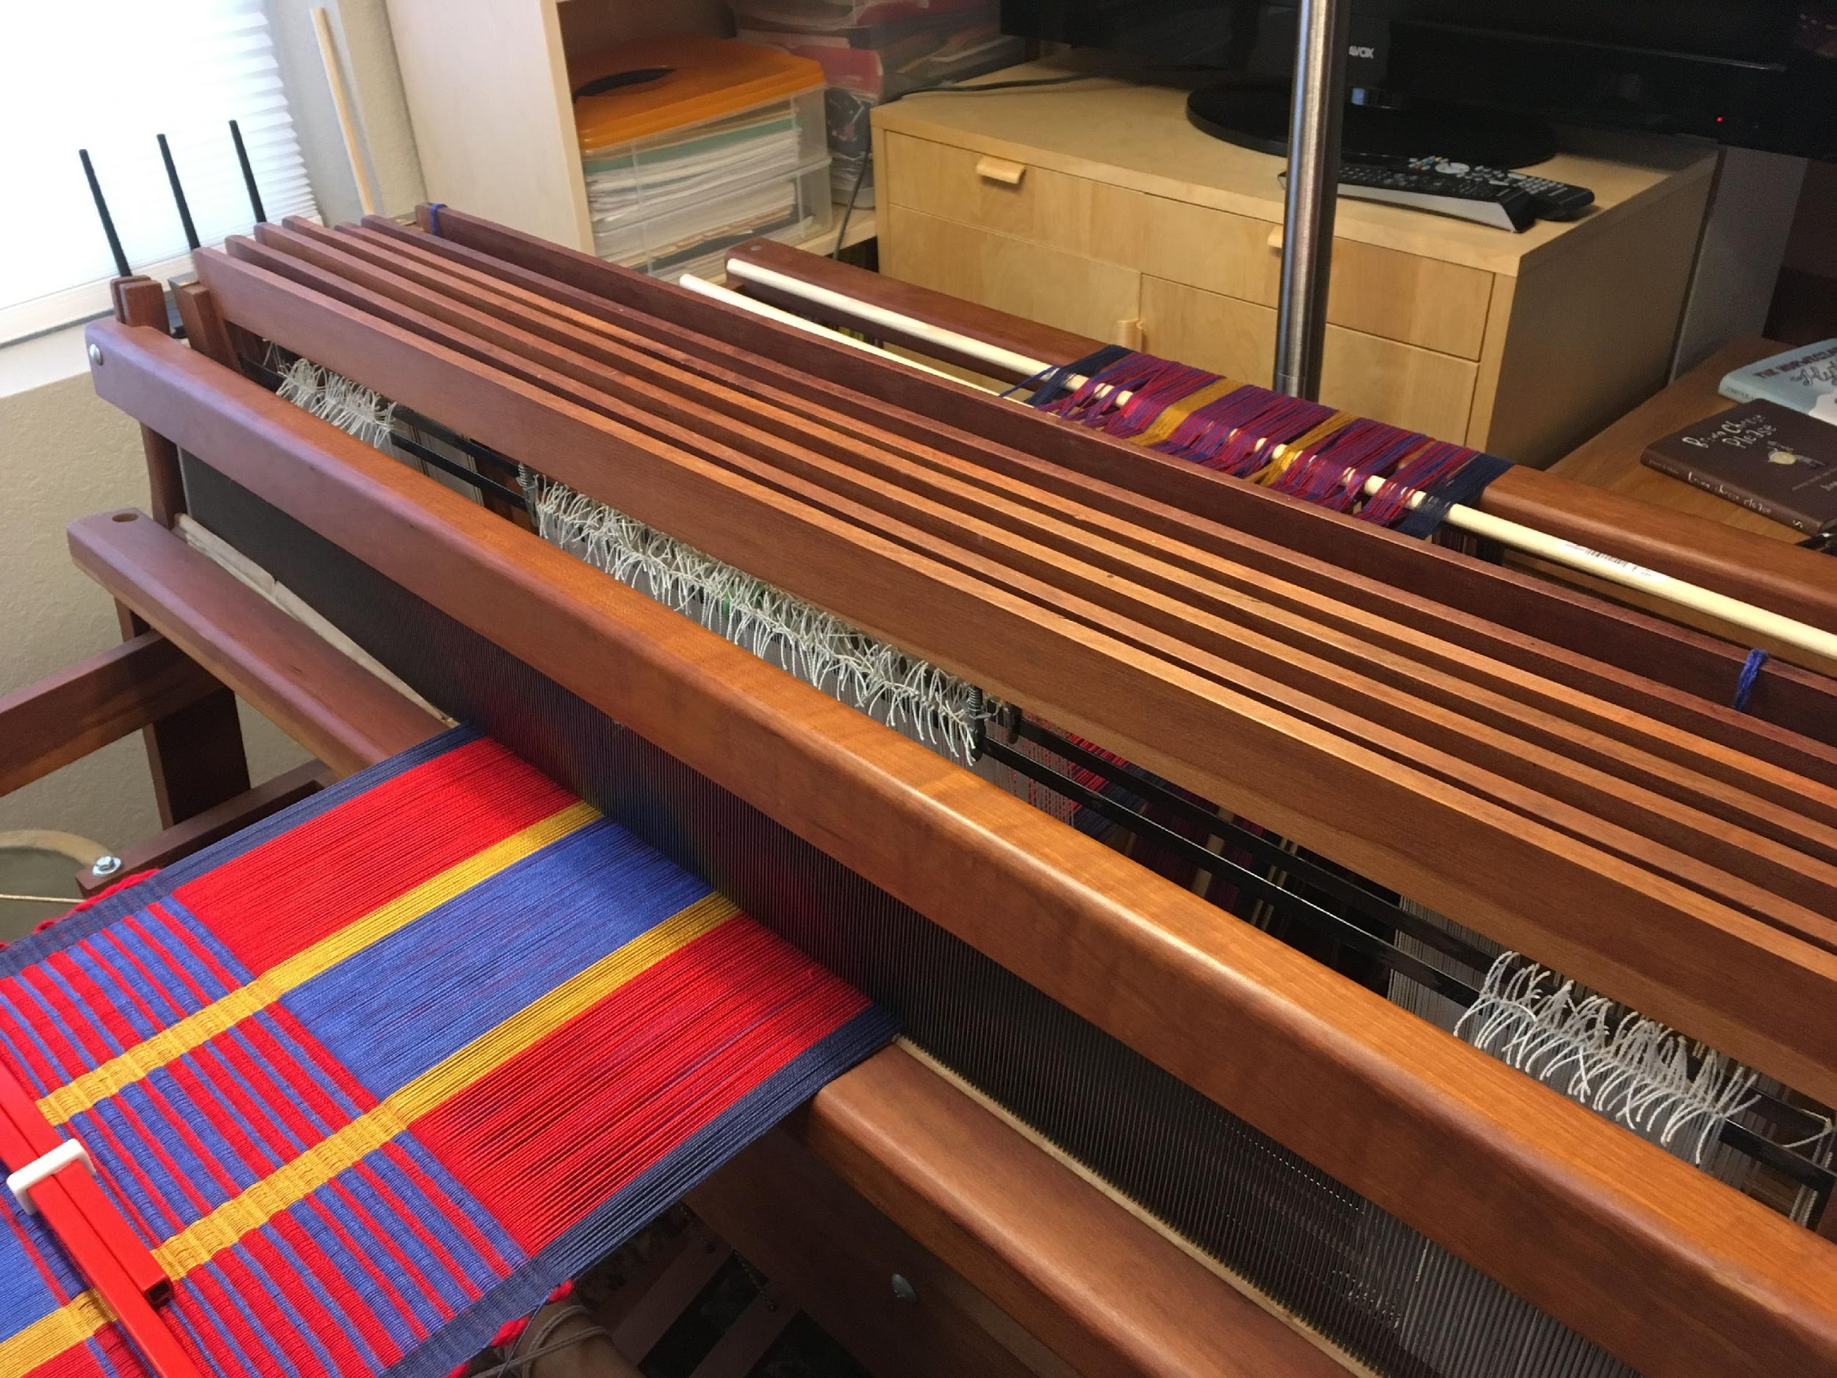
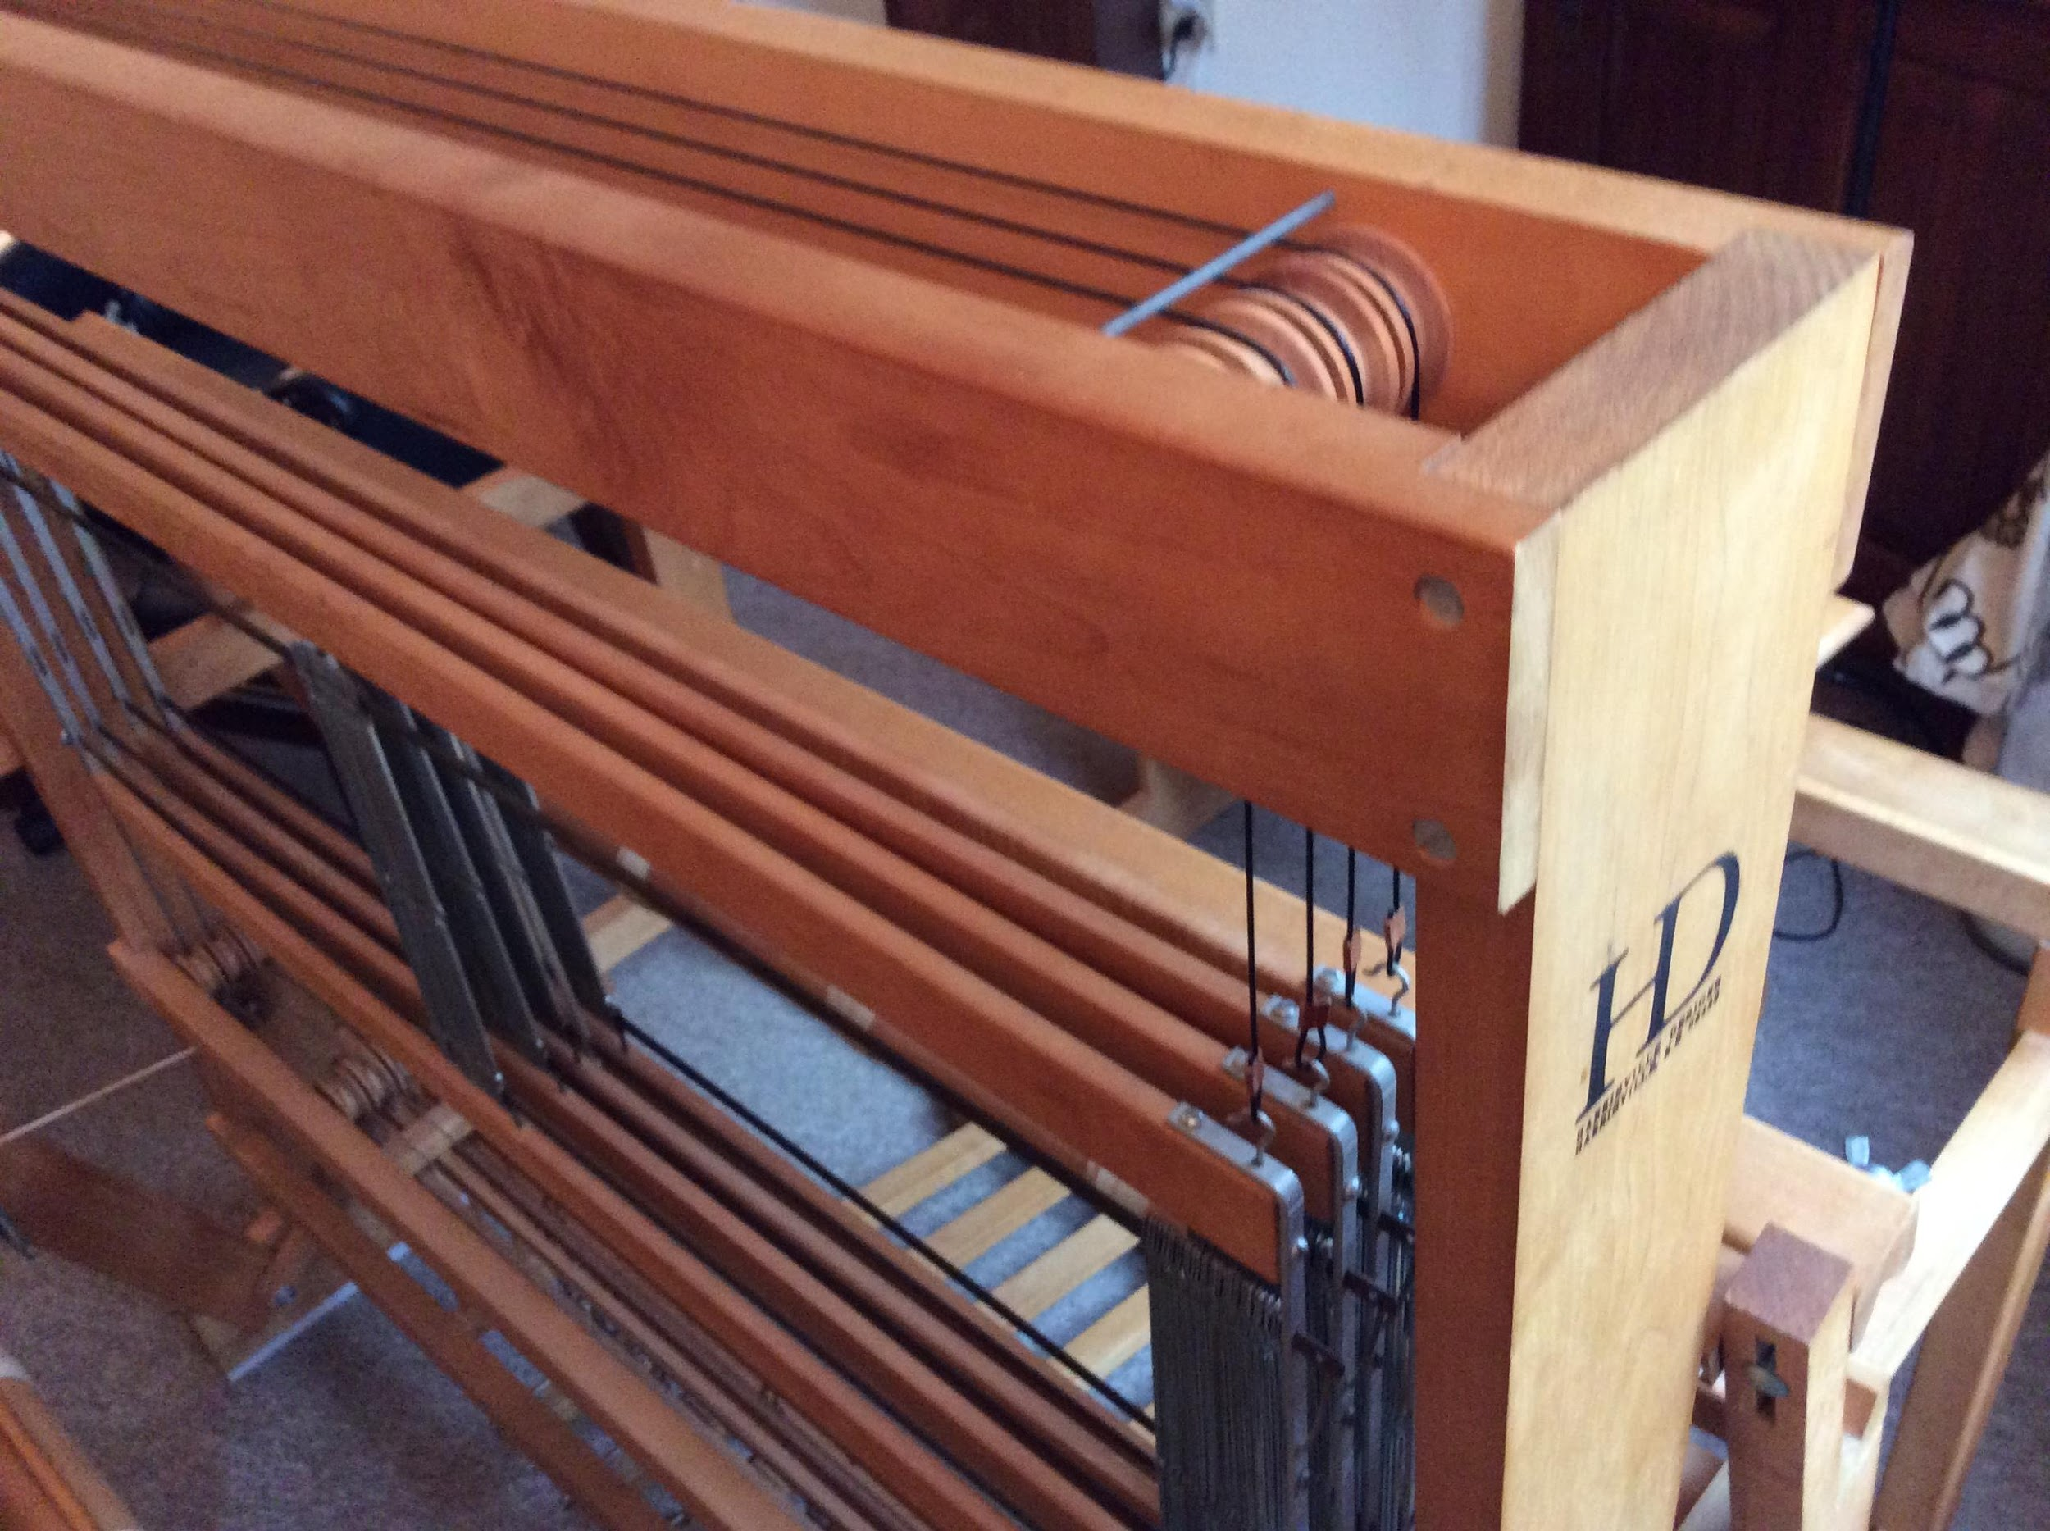
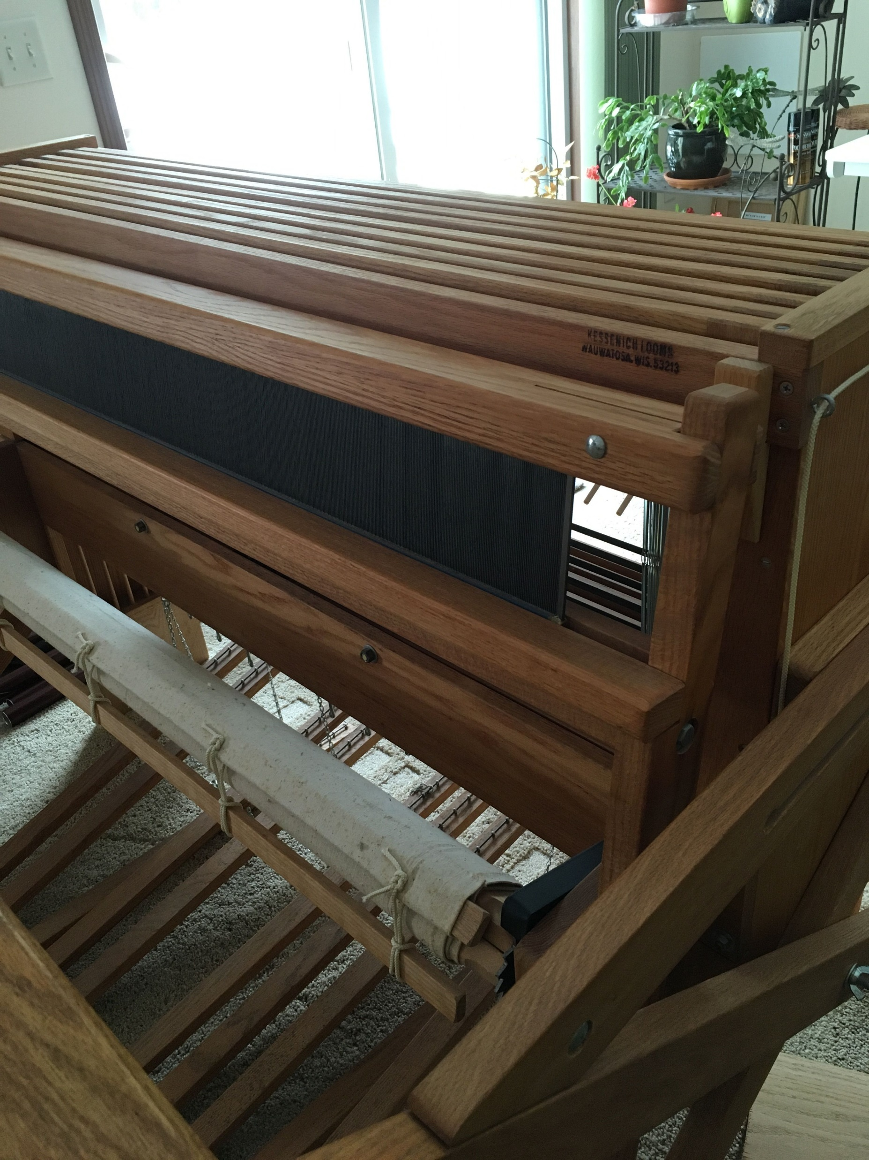
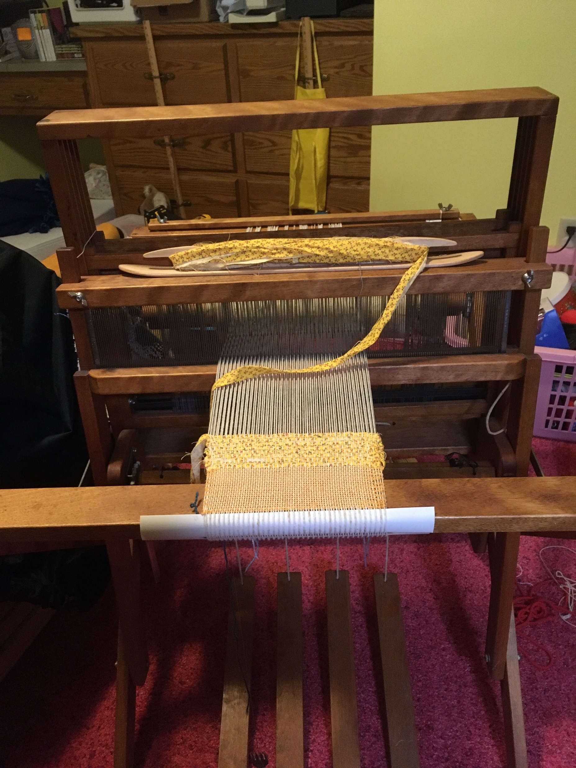
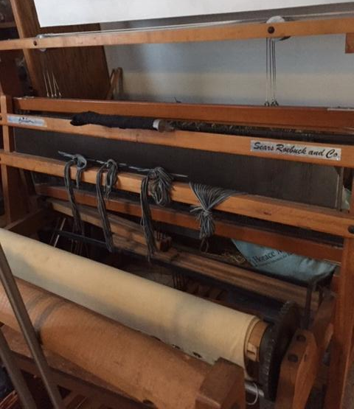
Harrisville Designs 4 shaft loom
Dorset direct tie up 4 shaft loom
Norwood 8 shaft jack loom
Newcomb 4 shaft jack loom- Sold by Sears
Kessenich 8 shaft jack loom

Slide 15
Counterbalance Looms by Glimakra LeClerc Hammett Union Orco
2,4,6,8 shafts
Footprints: 22x 36 to 65 x 72, 60-72 inches high.
Treadles are attached directly to the shafts. Rollers or pulleys move adjacent shafts to create sheds. Single or pairs of treadles are depressed to create sheds. Each treadle raises a shaft or shafts and lowers the paired shaft or shafts.
Some have overhead beaters. Some have underslung beaters.
String or texsolv heddles, easy to add or remove. Some have metal heddles.
Strong box for weaving rugs and fine linens.

Slide 16
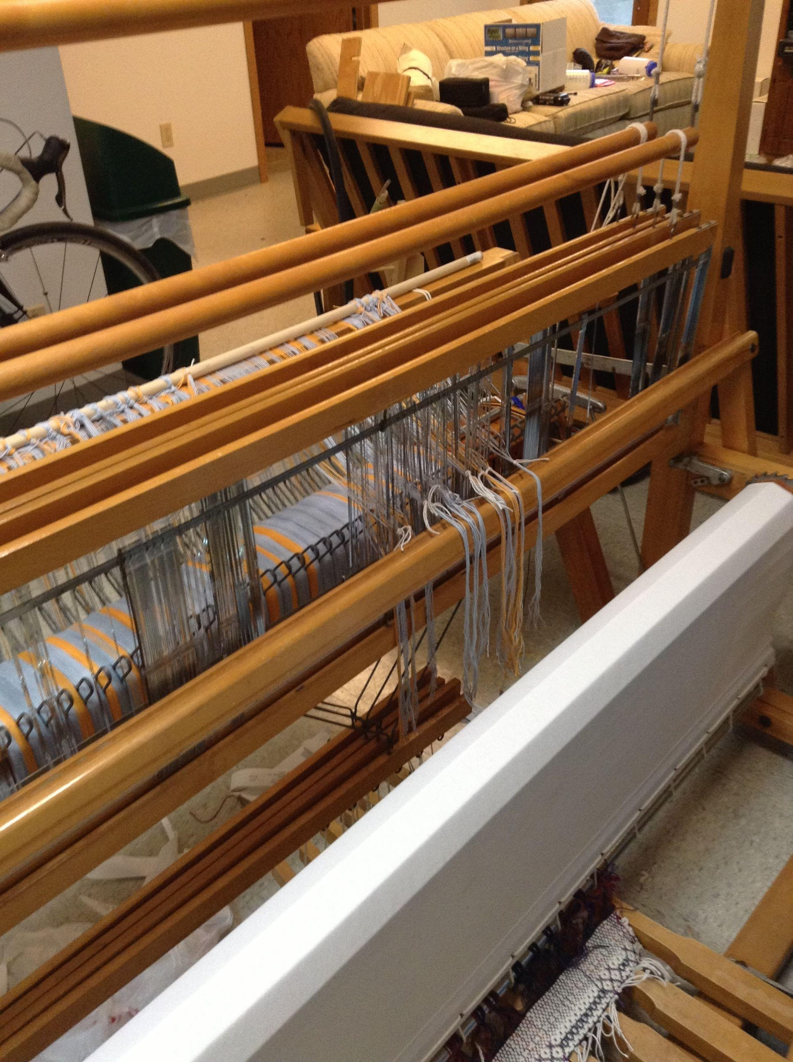
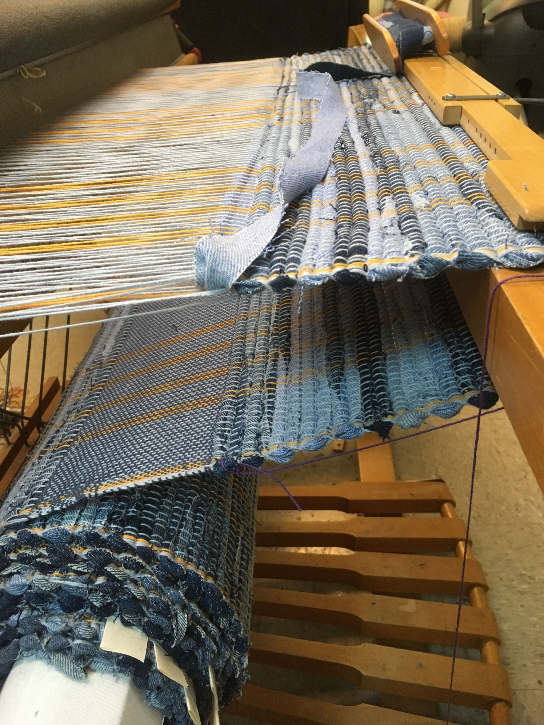
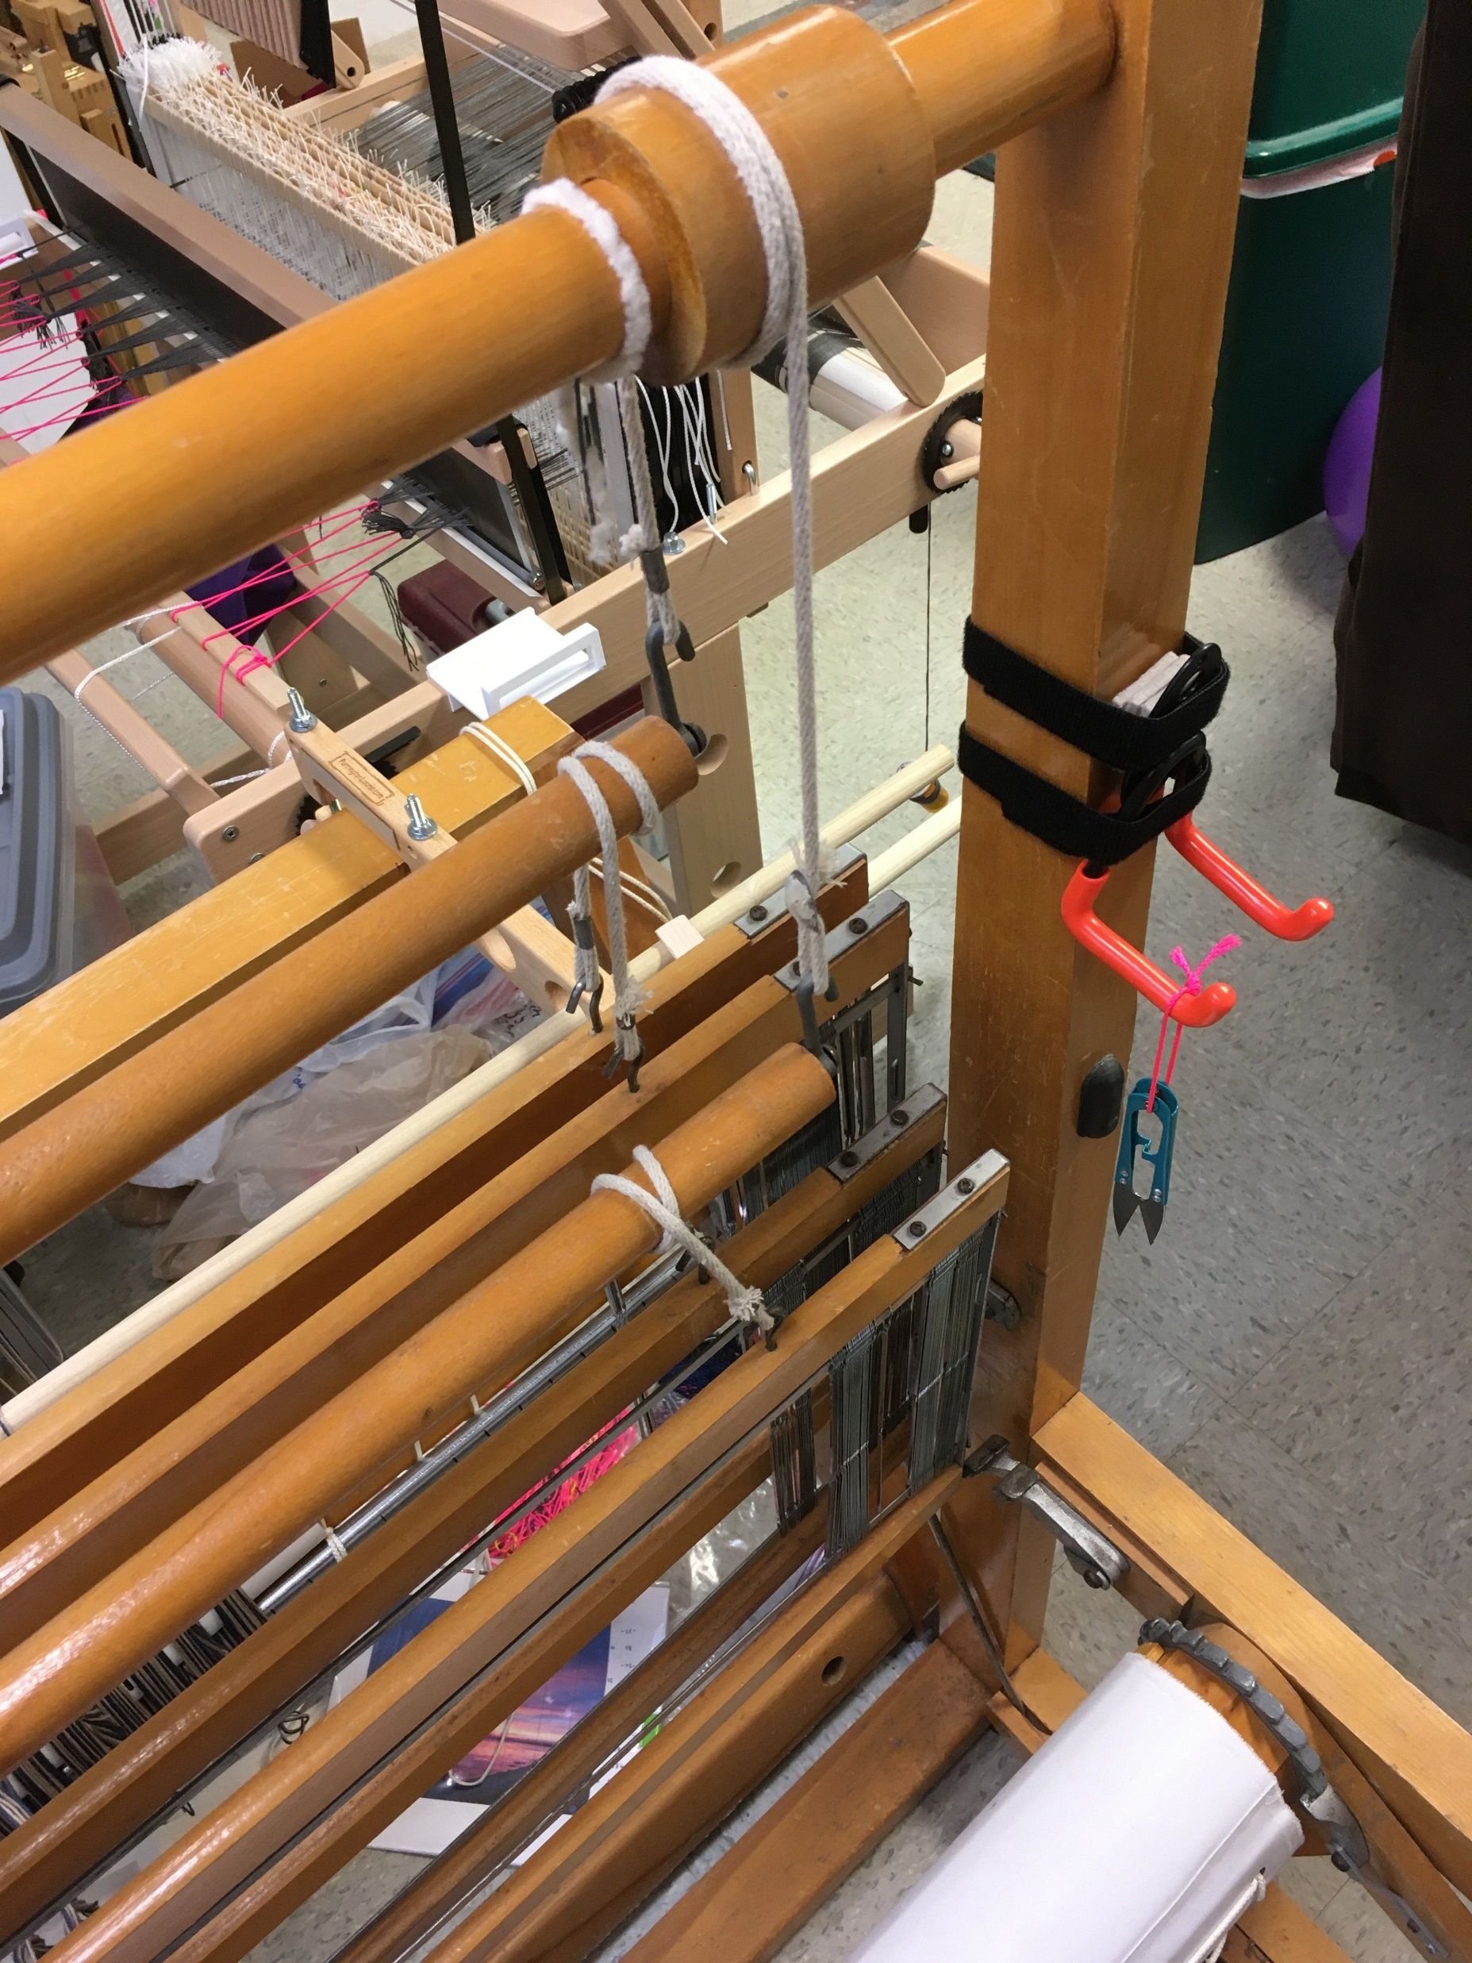
Counterbalance rollers on LeClerc Fanny
4 shaft loom
Cloth Beam and treadles

Slide 17
Countermarche Looms by Glimakra Cranbrook Toika Oxaback Louet
4,6,8,10, 12, 16 shafts
Footprints: 36x48 to 120x 72, 60-72 inches high.
Treadles are attached to two sets of lamms, so every shaft is moved by every treadle. Upper lamms pull shafts down, and lower lamms raise shafts up, so even tension on every warp string is maintained. Bars at the top are mounted horizontally or vertically to attach to shafts.
More work to do initial treadle tie ups. 4 shafts=16 connections, 8 shafts=64 connections
Overhead beater bar moves easily and uses less effort to beat, as the weight is held by the upper supports.
On some, front beam and beater bar remove easily for heddle access.
String or texsolv heddles usually. Easy to move texsolv heddles or add heddles.
Strong box for weaving everything from tight rugs to fine linens.

Slide 18
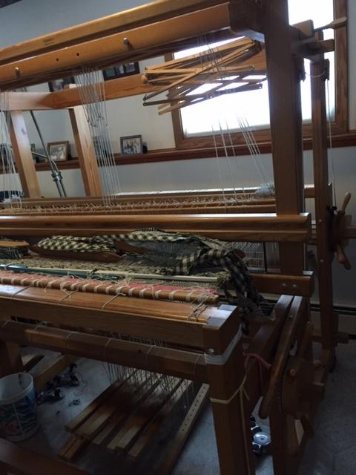
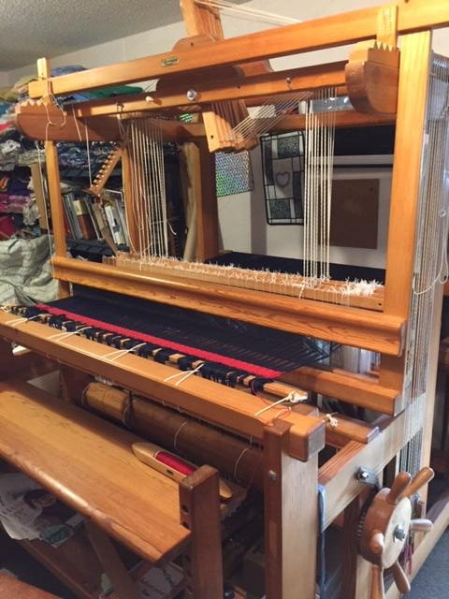
Glimakra 10 shaft horizontal countermarche loom
Oxaback 10 shaft vertical countermarche loom

Slide 19
Dobby Looms by Megado AVL
Works like a regular loom, but instead of treadles the shafts are controlled by a mechanism called a dobby. The dobby can use chains set by hand, or computerized with a weaving software program.
Advantages include no getting under the loom to tie up treadles and designs are not limited by the number of treadles, but only by the number of shafts.
One bar under the loom is depressed to raise the desired shafts. With each press of the bar, the next sequence of shafts is raised.
The shafts are raised by screws that are pushed out and that are caught by the dobby’s black bar.

Slide 20
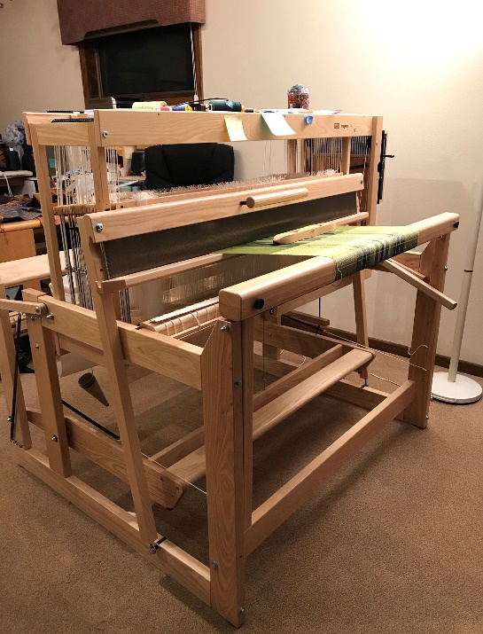
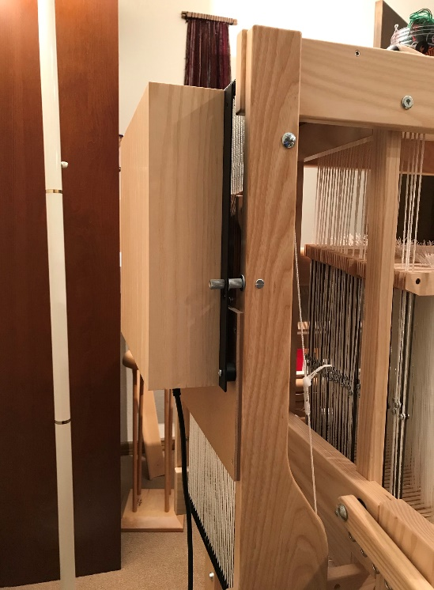
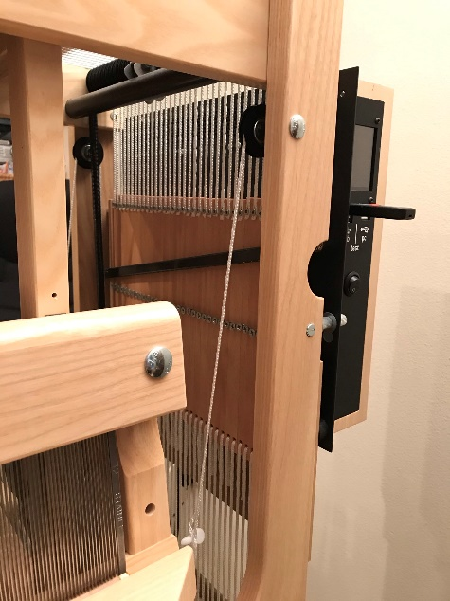
Dobby Looms
Computer box on the side of the loom controls the solenoids that cause the shafts to rise when the pushed out screws catch on the black bar.
Computer driven Dobby loom with single treadle bar to raise shafts in draft sequences.

Slide 21
Recommended Books:
For Rigid Heddle Looms:
Inventive Weaving on a Little Loom by Syne Mitchell
The Weaver’s Idea Book by Jane Patrick
For Floor Looms:
Learn to Weave by Deb Chandler
The Big Book of Weaving by Laila Lundell
The Weaver’s Companion by Handwoven Magazine
The Rag Rug Handbook by Janet Meany and Paula Pfaff

Slide 22
The right loom for me:
Fits my body, my budget, my space, and my weaving aspirations!
HAPPY WEAVING!

